Slide 1
New Features in openSUSE
Name goes here
Title goes here

Slide 2
Agenda
Why does openSUSE matter?
Infrastructure Changes
  Kernel
  systemd
Servers and Virtualisation
  OpenStack
Desktops
  GNOME 3.6
  KDE 4.10
  Enlightenment, XFCE, LXDE

Slide 3
Why does openSUSE matter?
Compilation of the 'latest and greatest' stable software available from the F/LOSS community
The Linux distribution for “Power Users” who want to get work done
  Capable as a Desktop, Server, Embedded (ARM), etc..
Upstream for SUSE Linux Enterprise
  SUSE Linux Enterprise 12 expected 2014
Notes:
SLE 11 was released March 2009, just after openSUSE 11.1

Slide 4
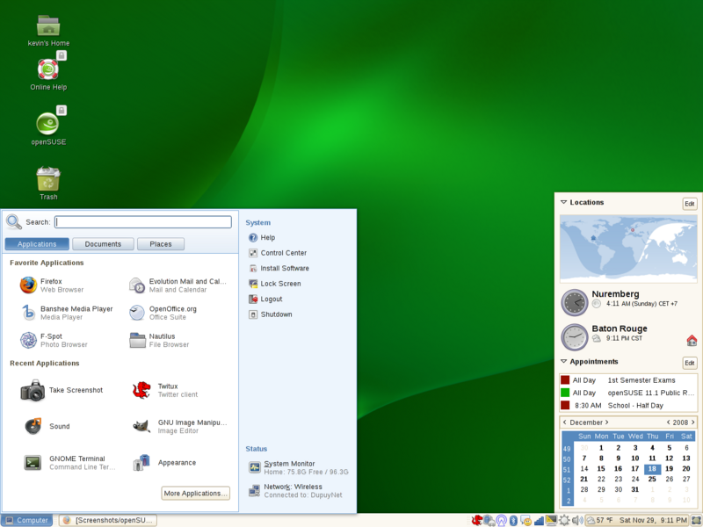
openSUSE 11.1 – released December 2008

Slide 5
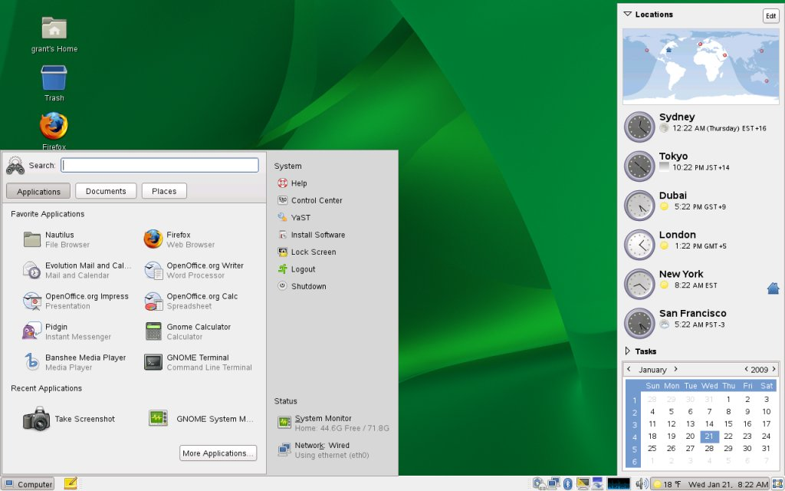
SLED 11 – released March 2009

Slide 6
Infrastructure - Kernel

Slide 7
Kernels 3.1 to 3.4 – Storage Highlights
linux-iscsi.org iSCSI target
ext4 – support for block sizes > 4KB
btrfs
  Metadata > 4KB – less fragmentation, improved performance
  Improved error handling – less btrfs Kernel panics
  Repair and Recovery tools – fsck & btrfs-restore
  RAID restriping – add RAID 0,1,10 after filesystem contains data
  Other performance improvements/tuning
'Thin Provisioning' – NSS-like Pool 'overbooking'
Notes:
Changed from SLE 11 SP2 to openSUSE 12.2
Ext4 bigger block sizes, more efficent, not backwards compatible with older kenerls
Brtfs-restore tries to recover files from broken btrfs
Restriping side effect of balancing improvements that allow pause/resume and status updates of balancing btrfs spanning multiple devices
Thin provisioning – dm layer

Slide 8
Kernels 3.1 to 3.4 – Other Highlights
Improved Hardware Support
  Better support for latest Geforce, AMD, and Intel GPU's
  Autoprobe x86 CPU capabilities – improved use of SSE/cpufreq drivers
EFI boot support (not Secure Boot)
cpupowerutils – improved HW monitoring
Teaming – improved bonding of network interfaces
  Round robin
  Active backup
Notes:
Changed from SLE 11 SP2 to openSUSE 12.2
Autoprobe CPU capabilities lets the kernel pick which SSE/cpufreq drivers are needed, instead of relying on distribution hacks

Slide 9
Kernels 3.5 to 3.7 – New to openSUSE 12.3
Android-style opportunistic suspend
  Enables devices to 'sleep by default' – dramatic power consumption improvements
Hybrid Suspend – suspend to disk & RAM at the same time
Multi-platform ARM support
Experimental SMBv2 Support
More btrfs improvements
  Subvolume quotas & quota groups
  Snapshot diffs
  ~20 hardlink per directory limit removed
Notes:
Multiplatform ARM – ARM finally like x86, doesn't need special kernel builds for slightly different hardware!

Slide 10
Infrastructure - systemd

Slide 11
systemd
Replacement for system V init
Aggressive parallelisation
  Userspace boot time ~2 seconds
'On-demand' activation of services
  Start less on boot, start more when needed
  Socket, D-Bus, Device-based activation of services
Process tracking
  cgroups instead of PIDs – daemons cannot 'escape' systemd even by double-forking
  Automatic restart of failed services
Dependency-based
  Services define which services they Require and Want and what must be loaded Before/After them
  Declarative 'unit files' instead of 'arcane' init scripts
Notes:
eg. cupsd only starts when the user first prints

Slide 12
systemd - Timeline
Previewed in openSUSE 11.4
Default in openSUSE 12.1
sysVinit removed in openSUSE 12.3

Slide 13
systemd – what you need to know
sysVinit had Runlevels, Numbered 0-5
  0 – shutdown
  1 – single user mode
  3 – multiuser with network
  5 – multiuser with network and X
Systemd has “target units”
  halt.target (aliases – runlevel0.target, poweroff.target)
  rescue.target (aliases – runlevel1.target)
  multi-user.target (aliases – runlevel3.target)
  graphical.target (aliases – runlevel5.target)

Slide 14
systemd – what you need to know
Changing targets
  init <runlevel number> - still works, but deprecated
Instead
  systemctl isolate <my_target>.target
    eg. systemctl isolate multi-user.target

Slide 15
systemd – what you need to know
systemd ignores /etc/inittab
Instead create custom target
  Create /etc/systemd/system/<target_name>.target
    copy existing target for ease
    Define “hard”/requires dependencies in the file
  For “soft”/wanted dependencies
    Create a directory called /etc/systemd/system/<target_name>.target.wants/
      Symlink each .service from /lib/systemd/system into <target_name>.target.wants directory
  Reload systemd configuration to make target available
    Systemctl daemon-reload
  To make new target the default
    ln -sf /etc/systemd/system/<target_name>.target /etc/systemd/system/default.target

Slide 16
systemd – what you need to know
Controlling Services
  /etc/init.d/<service> <subcommand> - still works, but deprecated
  rc<service> <subcommand> - still works, but deprecated
Instead use
  systemctl <subcommand> <service>
    eg. systemctl start network

Slide 17
systemd – what you need to know
Enabling/Disabling Services
  insserv (-r) <service> - still works, but deprecated
  chkconfig <service> <on/off> - still works, but deprecated
Instead use
  systemctl enable <service>
  systemctl disable <service>
    eg. systemctl enable network
      eg. systemctl disable network

Slide 18
systemd – Boot Analysis
Install systemd-analyze
  zypper in systemd-analyze
See how fast your system boots
  systemd-analyze
Figure out what takes the most time to start during boot
  systemd-analyze blame
Draw pretty diagram to see what really slows down your boot times
  systemd-analyze plot > file.svg

Slide 19
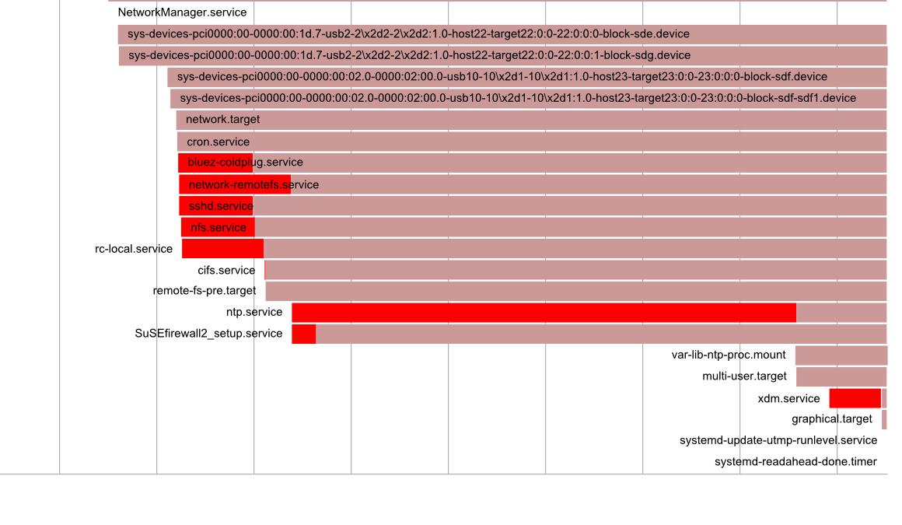
systemd-analyze plot

Slide 20
systemd Futures
Syslog replacement – Journald
  “Service aware” - see log entries for Foo service, prevents services from lying about who they are
  Able to capture/retrieve coredumps
  Local only - able to coexist with syslog for remote logging
Lightweight containers - systemd-nspawn
  chroot++
  Boot sandboxed OS installation without LXC or Virtualisation
  Not as isolated/secure as a VM, but 'good enough' for many use cases
Now consider systemd's socket activation
  Services, Containers & VM's autostarting only when users try and contact them
    Resource management & Green computing heaven?

Slide 21
Servers and Virtualisation

Slide 22
Server Developments - Databases
MariaDB replaces MySQL as default database server
  More storage engines (XtraDB – fork of InnoDB)
  Lots of performance & feature improvements over MySQL
    Tested with 200,000+ connections
  Optional drop-in replacement for upgrades
  MySQL still included in openSUSE
PostgreSQL 9.2
  Native JSON support – use PostgreSQL like a 'NoSQL' document database
  Improved scalability & performance (2-20x faster)

Slide 23
Server Developments – Other Highlights
BIND 9.9
  Inline signing – Simplified deployment of DNSSEC
Tomcat 7
  Servlet 3.0, JSP 2.2, EL 2.2
Squid 3.2.6
  Client Bandwidth Limits, IPv6, SMP scalability, better streaming support
WebYaST
  “Finally works” on openSUSE 12.3
Nagios 3.4.4
  Bugfixs/security - simplified Install
Notes:
Nagios automatically makes user/groups needed

Slide 24
Server Developments – Coming Soon
Samba 4
Able to serve as a Full Active Directory Domain Controller
  AD LDAP
  Heimdal Kerberos Server (KDC)
  Dynamic DNS Server
  Supports Group Policy, Roaming Profiles, Exchange, etc
  Able to trust & join Microsoft AD Domains
  SMB v2, 2.1 & 3 (Already available in Samba 3.x)
  Created with Microsoft documentation & interoperability testing
  Clustered File Server Support
Notes:
Nagios automatically makes user/groups needed

Slide 25
Virtualisation - Highlights
KVM
  SPICE, qxl & USB3 support, USB redirection supports live migration
Xen 4.2.1
  'xl' replaces 'xm/xend' tools – SPICE support, but no qxl or USB pass-through
  EFI support
  Scalability/density improvements
    Support for 4095 CPUs and upto 5TB RAM on 64-bit hosts
    Upto 512 VCPUs per Paravirtualised VM, 256 VCPUs per 'Fully Virtualised' VM
LXC 0.8.0
  Apparmor support
  Container 'imaging' with lxc-clone – supports LVM2 and btrfs snapshots
  yast2-lxc – simple management of LXC Containers
Notes:
SPICE – multiple data channel, vVNC replacement
Qxl is a componant of spice, virtualised GPU used with spice to get accelerated/smooth remote desktop

Slide 26
Cloud - OpenStack
First release of openSUSE with complete packages for OpenStack
DevStack – developer tools/scripts to quickly build simple OpenStack test/dev environments
Improved Web Dashboard
Image replication
New API and client tool for image service
Return of Hyper-V support
Public-Key authentication
Notes:
The Stuff behind SUSECloud

Slide 27
Desktops

Slide 28
GNOME 3.6
Design driven. Clean, simple to use, but still powerful
  “Mac-like”
  “The Opinionated Desktop”
Integrated applications
  Documents – Browse/Search local, network and 'cloud' documents
  Disks – Powerful user tool for Disk/Removable media management
  Empathy – Integrated messaging - “Distraction Free computing”
  Files – Search that works, and improved workflows
  Boxes – KVM Desktop virtualisation – Bye Bye Virtualbox!
'Online Accounts' integration
  Simple Google, Windows Live, Active Directory authentication/integration

Slide 29
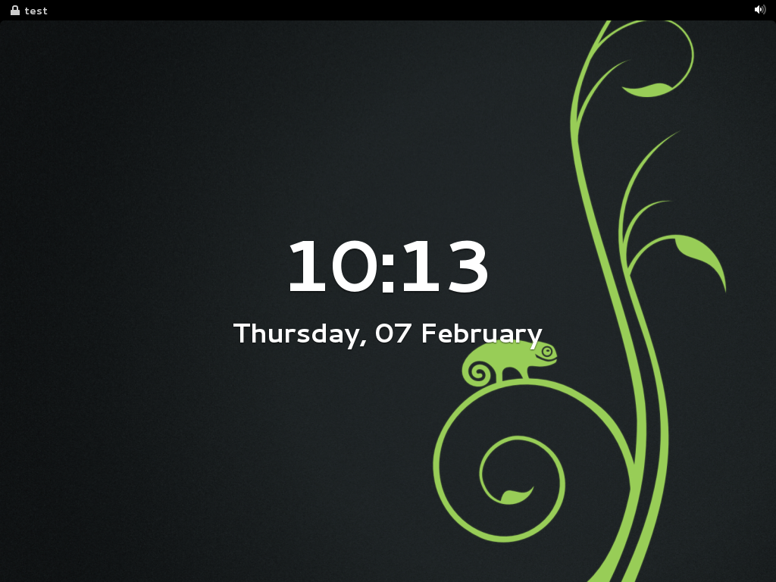
GNOME 3.6 – Useful Lock Screen

Slide 30
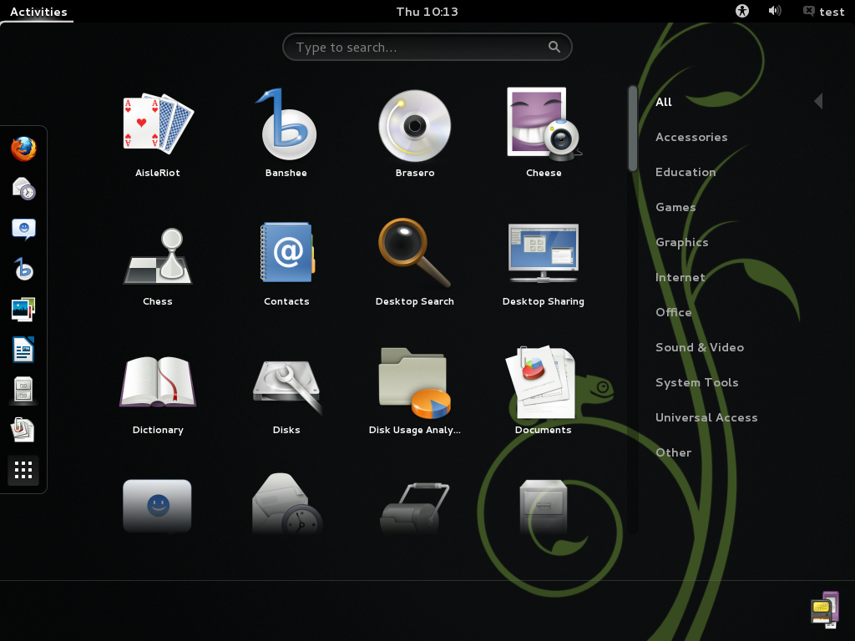
GNOME 3.6 – Activities Menu

Slide 31
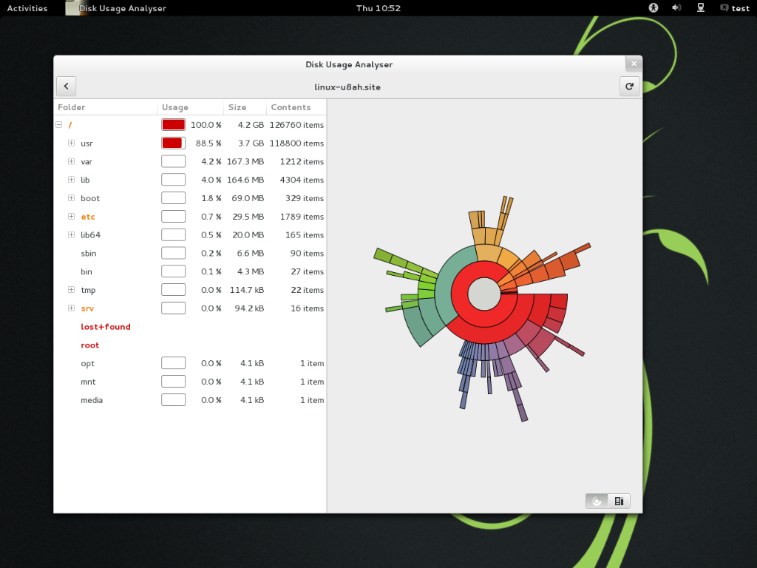
GNOME 3.6 – Disk Usage Analyser

Slide 32
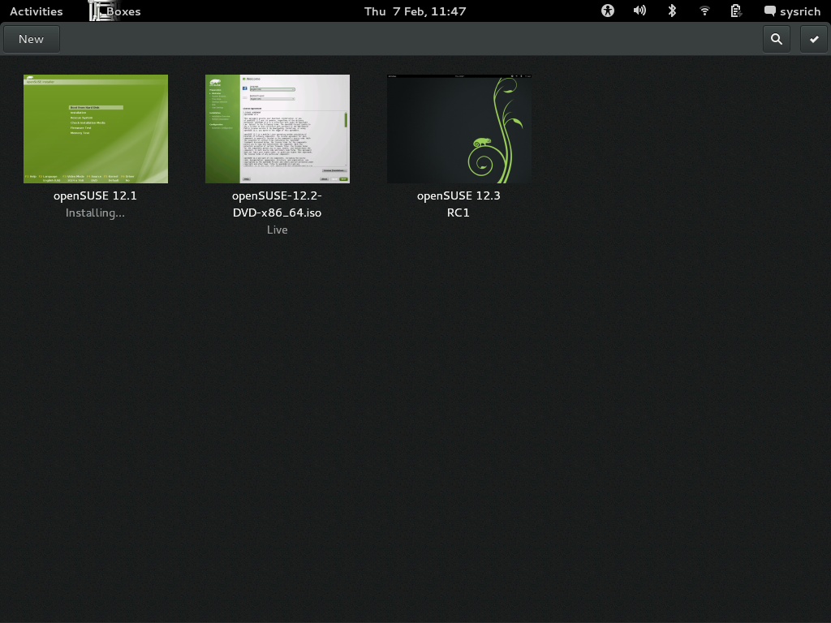
GNOME 3.6 – Boxes

Slide 33
KDE 4.10
Showcase for the capabilities of Qt
Window Management improvements
  Scripting support to add functionality/effects to Kwin
  openGL support in most Vms
  Per-monitor colour management
Menu customisations – replace Application menu with Title bar button
File Manager performance improvements
New Print Manager – support for latest CUPS
Nepomuk cleaner – tidy up metadata storage

Slide 34
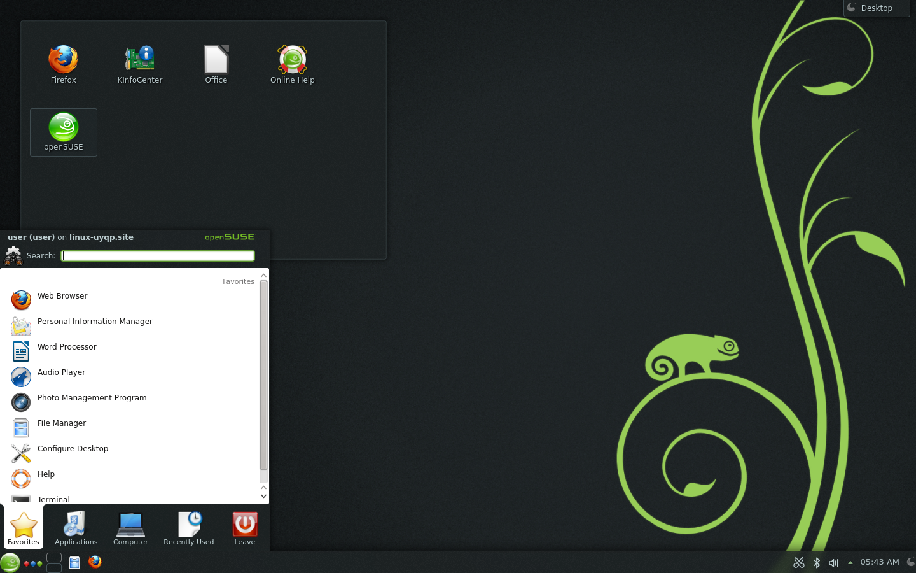
KDE 4.10 – Plasma Desktop

Slide 35
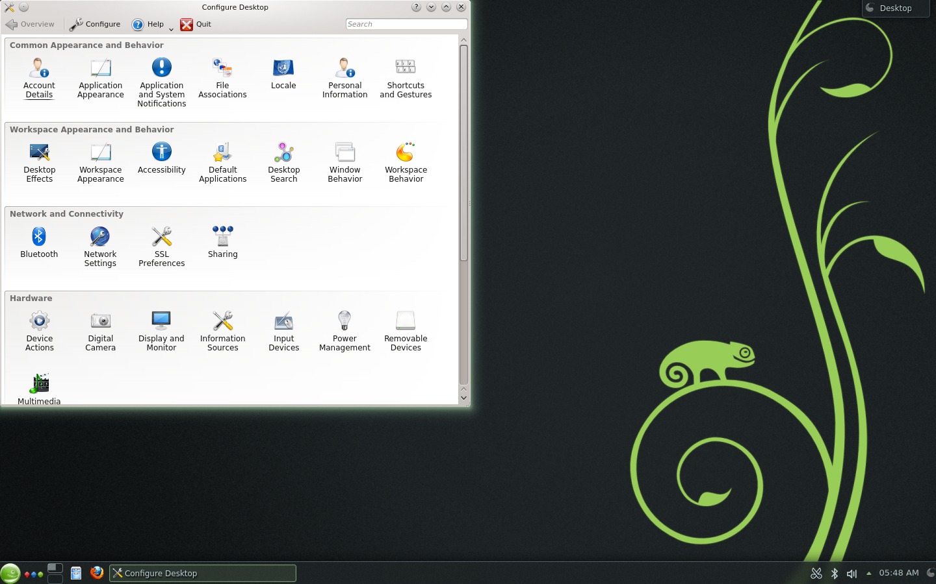
KDE 4.10 – Configuration

Slide 36
Other Desktops/Window Managers
XFCE 4.10 – Lighter than GNOME or KDE, 'full-featured'
LXDE 0.5.5 – Even lighter, but less features
Enlightenment E17 – Very nice on ARM devices (Chromebooks)
Window Managers
Awesome – extremely small and fast – extend it with Lua
Sawfish – Powerful keybinding, events, window rules, themeing
Notes:
Lua programming lanage

